Slide 1
Trauma Informed Care,
For All
ACEs and Single Payer

Slide 2
The ACE Study
Abuse, by category Prevalence (%)
Psychological (by parents) 11%
Physical (by parents) 28%
Sexual (anyone) 22%
Neglect, by category
Emotional 15%
Physical 10%
Household Dysfunction, by category
Alcoholism or drug use in home 27%
Loss of biological parent < age 18 23%
Depression or mental illness in home 17%
Mother treated violently 13%
Imprisoned household member 5%
Notes:
Surveyed over 17,000 adults - very high response rate
Mostly white, middle and upper class, college educated - all members of a Kaiser Permanente HMO
Compared surveys to mortality and morbidity

Slide 3
Findings
ACE Score | Women | Men | Total
0 | 34.5 | 38.0 | 36.1
1 | 24.5 | 27.9 | 26.0
2 | 15.5 | 16.4 | 15.9
3 | 10.3 | 8.6 | 9.5
4 or more | 15.2 | 9.2 | 12.5

Slide 4
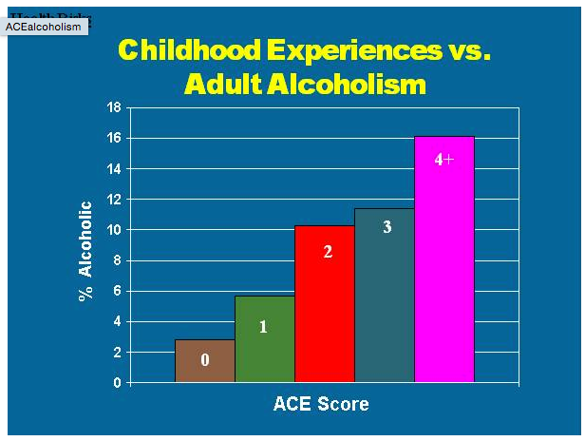
Image: http://acestoohigh.com/got-your-ace-score/

Slide 5
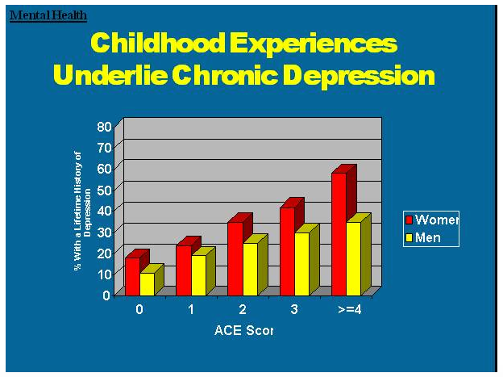
Image: http://acestoohigh.com/got-your-ace-score/

Slide 6
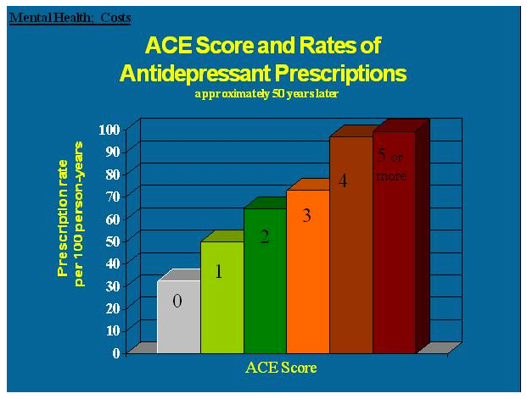
Image: http://acestoohigh.com/got-your-ace-score/

Slide 7
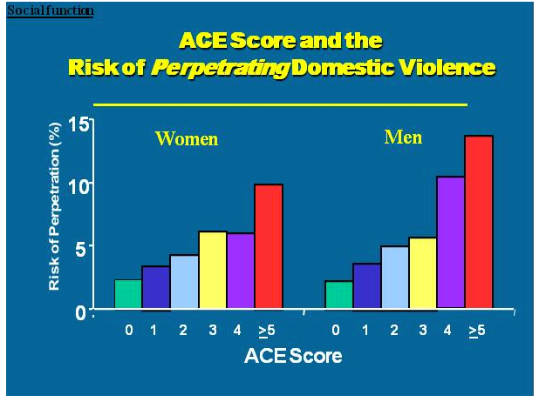
Image: http://acestoohigh.com/got-your-ace-score/

Slide 8
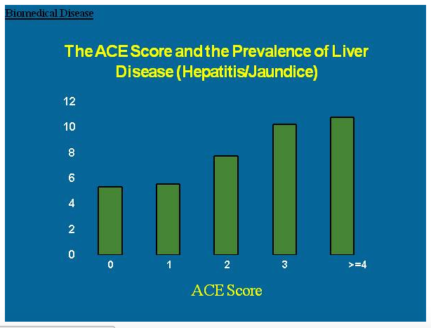
Image: http://acestoohigh.com/got-your-ace-score/

Slide 9
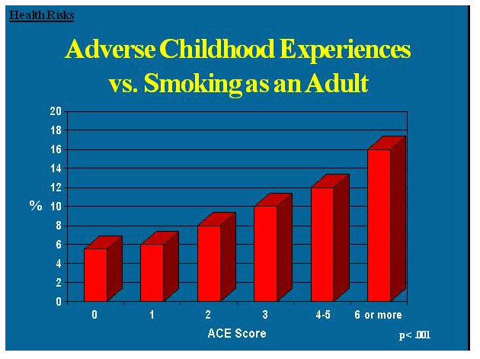
Image: http://acestoohigh.com/got-your-ace-score/

Slide 10
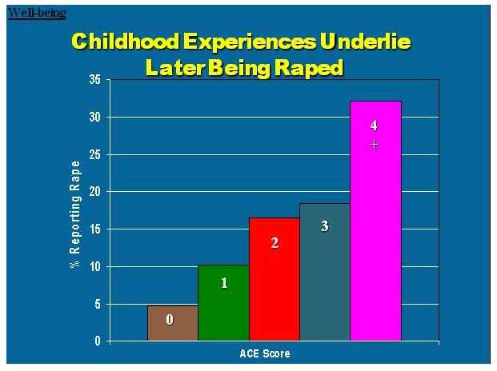
Image: http://acestoohigh.com/got-your-ace-score/

Slide 11
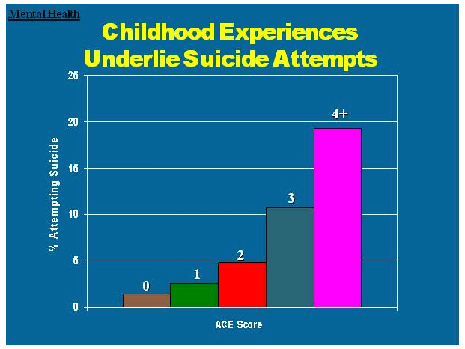
Image: http://acestoohigh.com/got-your-ace-score/

Slide 12
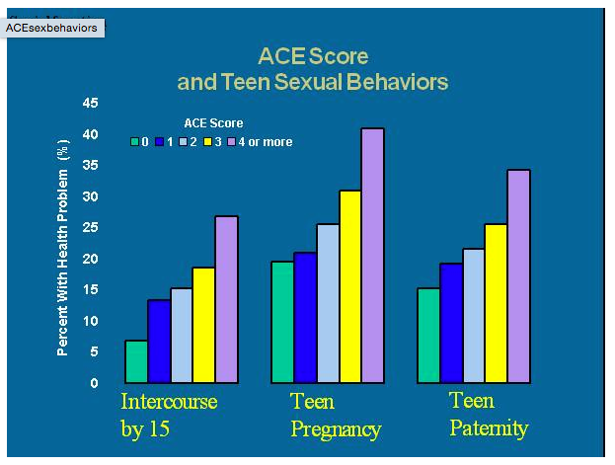
Image: http://acestoohigh.com/got-your-ace-score/

Slide 13
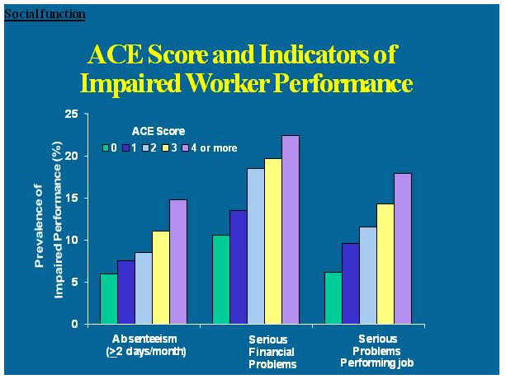
Image: http://acestoohigh.com/got-your-ace-score/

Slide 14
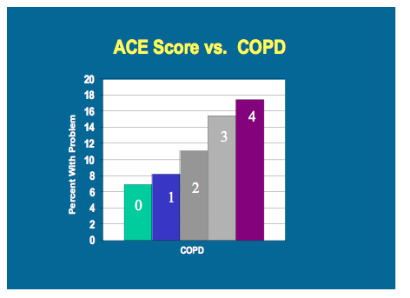
Image: http://acestoohigh.com/got-your-ace-score/

Slide 15
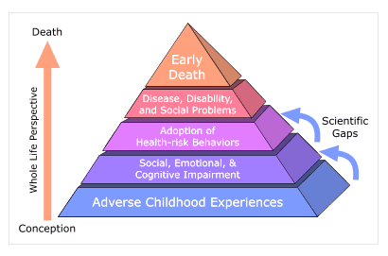
ACE Pyramid
Image: http://www.cdc.gov/violenceprevention/acestudy/pyramid.html

Slide 16
Understanding ACE Scores
“Trauma is the nation’s most basic public health problem” - Dr. Vince Felitti
Recognized risk factor for risky behavior, chronic disease, social instability, and premature death
Risk factors can be aggravated or alleviated by systems
Notes:
Not a sentence, but a risk factor - should be acknowledged

Slide 17
Tenants of Trauma-Informed Systems
Realizes the widespread impact of trauma and understands potential paths for recovery
Recognizes the signs and symptoms of trauma in clients, families, staff, and others involved with the system
Responds by fully integrating knowledge about trauma into policies, procedures, and practices
Seeks to actively resist re-traumatization
Notes:
Tell story of trauma and how it can be re-activated by systems that place barriers
Ask people to brainstorm why single payer would be better for patients who’ve experienced trauma

Slide 18
Why Single Payer
Eliminate barriers to care that can trigger re-traumatization
Improve access to behavioral and mental health services
Provide continuous, uninterrupted care to those who need it most

Slide 19

Envisioning a Trauma-Informed Single Payer System

Slide 20
More resources for trauma informed care
acestoohigh.com
CDC - http://www.cdc.gov/violenceprevention/acestudy/index.html
SAMHSA - http://www.samhsa.gov/nctic/trauma-interventions
The Sanctuary Model - http://www.sanctuaryweb.com/

